Slide 1







The AIC journey to engineering a more reliable and coordinated approach to health care delivery
Presentation to the MA Coalition
April 11, 2016
Sara J. Singer, PhD MBA, Principal Investigator, Harvard Chan, HMS, MGH
Russell S. Phillips, MD, Co-PI, HMS Center for Primary Care, BIDMC
James C. Benneyan, PhD, Co-PI, Healthcare Systems Engineering Institute, Northeastern

Slide 2
AIC provides foundation supporting EHRLL
Program
Purpose
Objectives
EHRLL
Address harder nuts | Apply systems engineering approaches to IT enabled workflows at the intersection of primary/specialty care that require coordination across teams
Apply tools to real problems | More team-based care Colorectal and breast cancer or developmental screening; patients at high risk of harm Spread
Build foundation | Transform to team-based care Manage population health Engage patients Involve residents
CARES Initiative
Academic Innovations Collaborative

Slide 3

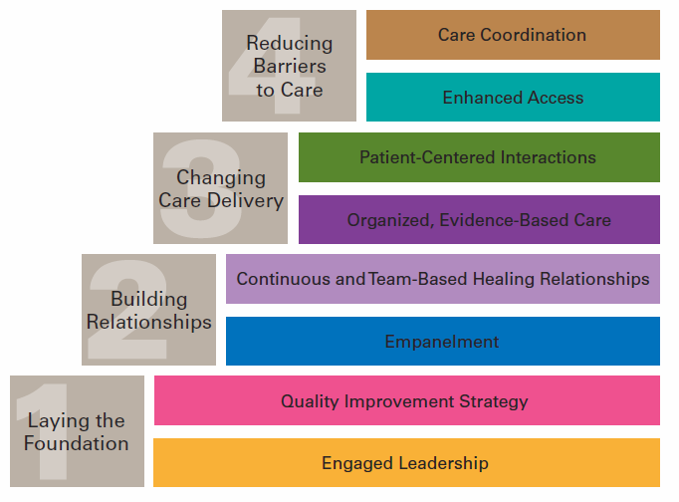

Change Concepts for AIC Practice Transformation
Wagner EH, Coleman K, Reid RJ, Phillips K, Abrams MK, Sugarman JR. The Changes Involved in Patient-Centered Medical Home Transformation. Primary Care: Clinics in Office Practice. 2012; 39:241-259.
Notes:
2
17

Slide 4
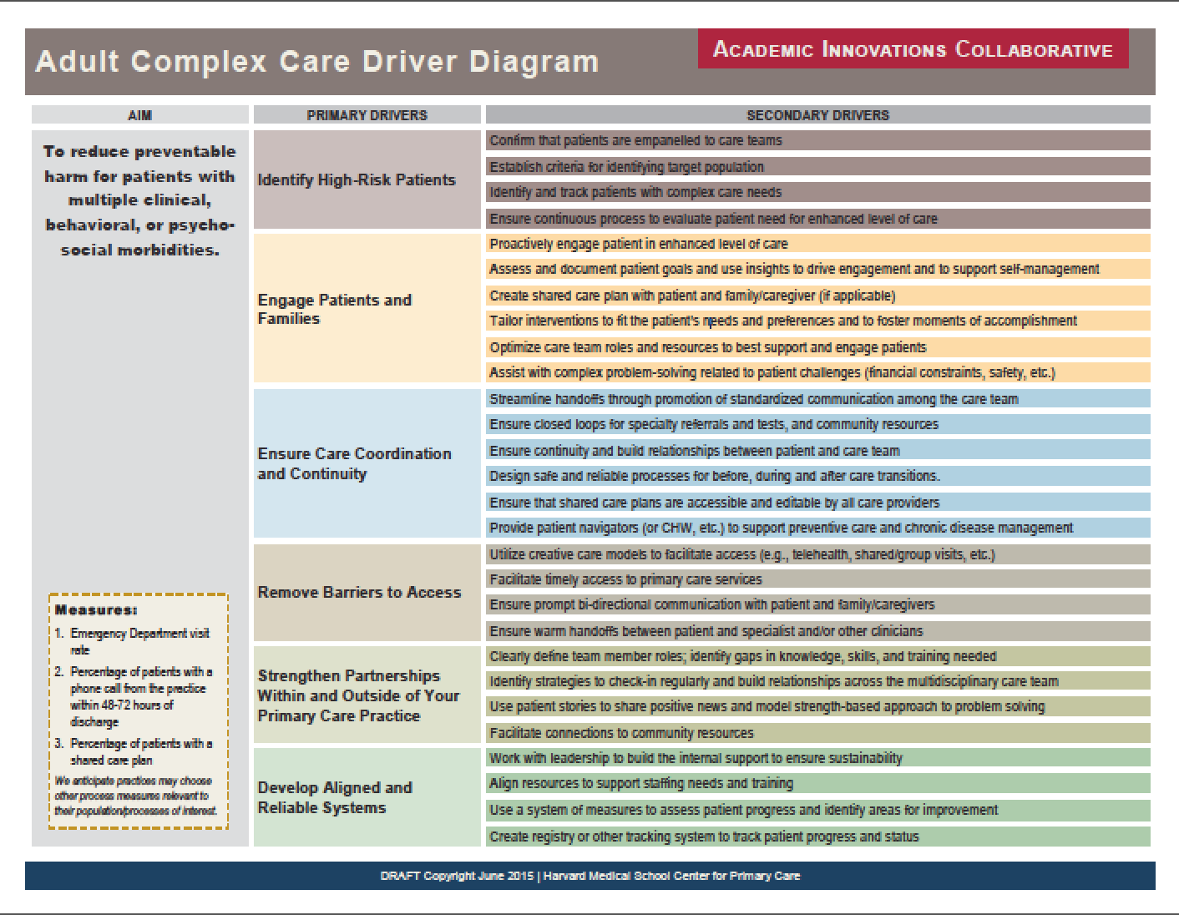

Slide 5
Evidence of impact:
Improved Team Dynamics for Physicians, Staff, and Residents
6% Δ*
3% Δ
3% Δ
6% Δ***
6% Δ***
6% Δ***
  * p < 0.05
  ** p < 0.01
  *** p < 0.001

Slide 6
Improved Clinical Work Satisfaction and Perceived Quality of Primary Care Handoffs, All Staff
2% Δ
0% Δ
5% Δ***
3% Δ
  * p < 0.05
  ** p < 0.01
  *** p < 0.001

Slide 7
Teaming explains medical assistants’ greater satisfaction despite more work
Intervention
Team-based care
Population management
Mechanisms
Greater sense of organization
Easier communication
Stronger relationships with patients
Stronger relationships with doctors
Greater sense of efficacy & ownership
More learning opportunities
Results
Increased job satisfaction
More positive perceptions of teamwork
--Gerstein, Chien, Peters, Rosenthal, Singer. “The Medical Assistant Experience in Team-Based Primary Care: A Qualitative study,” forthcoming.

Slide 8
Teaming supported residents in overcoming complexity
Operational complexity
Clinical complexity
(Empowered) patient complexity
--Veazey Brooks, Peters, Rosenthal, Chien, Singer. “Recognizing the Complexity in Primary Care Medicine: Residents' Experiences at Continuity Clinic,” forthcoming.

Slide 9
Team-based transformation related to across the board improvement in patient experience
Category | 2011 | 2013
Communication | 94.1 | 95.1
Integration of Care | 86.7 | 88.1
Knowledge of Patient | 88.6 | 90.3^
Organizational Access | 79.0^ | 80.2^*
Office Staff | 86.5 | 88.5
Would Recommend | 90.0 | 91.4
^Significantly different from controls.
*Difference in difference between intervention and controls over time is significant.

Slide 10
EHRLL innovation
Integration of systems engineering (SE) and operations management theory and methodologies
Rigorous learning program guided by innovative theory of learning
Embedded SE teams
EHRLL
Research project
Engine Core SE Triad Postdoc staff Graduate student Undergrad student | Healthcare System Principal investigator R&D Team Project management
Patients and family members
Interdisciplinary ecosystem to foster clinician-patient-engineer research partnerships

Slide 11
Thank you
Engineering High Reliability Learning Lab
ssinger@hsph.harvard.edu
© 2011 I-PASS Study Group/Children’s Hospital Boston All Rights Reserved. For Permissions contact ipass.study@childrens.harvard.edu

